Slide 1
Prioritizing and Classifying 8-K Information
Mauricio Codesso
Jamie Freiman

Slide 2
Downloading Data
Extract Text from PDFs
Cleaning Process
Exploratory Data Analysis
Model Development

Slide 3
Downloading Data EmpresaNet
Download 8500 files from January 2010 to March 2017
7 Categories:
Cancelamento de Registro / Cancelations
Stock Control
Direito de Preferência / Right of first refusal
Dividends
Public Offering
Request for Judicial Recovery /
bankruptcy
Share subscription

Slide 4
Extract and Cleaning Data
Development of a script for extracting and processing the texts of the files in PDF
Deletion of encrypted and corrupted files
Final files after extraction and cleaning: 6837

Slide 5
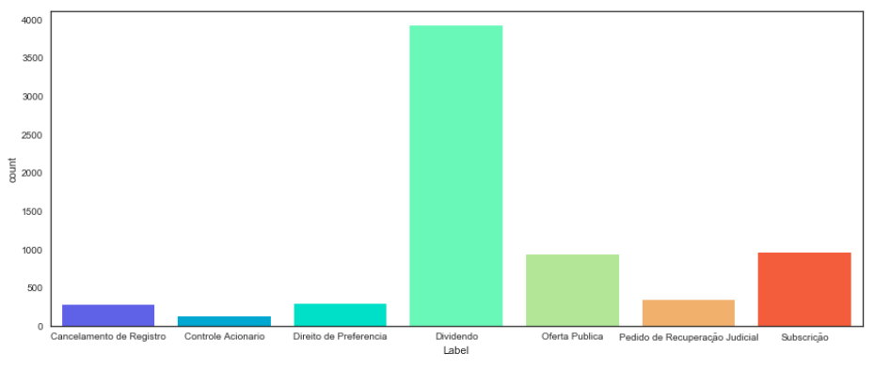
Exploratory Analysis
Categories | Files
Cancelamento de Registro | 282
Stock Control | 128
Direito de Preferência / Right of first refusal | 292
Dividends | 3919
Public Offering | 928
Request for Judicial Recovery / bankruptcy | 333
Share subscription | 955

Slide 6
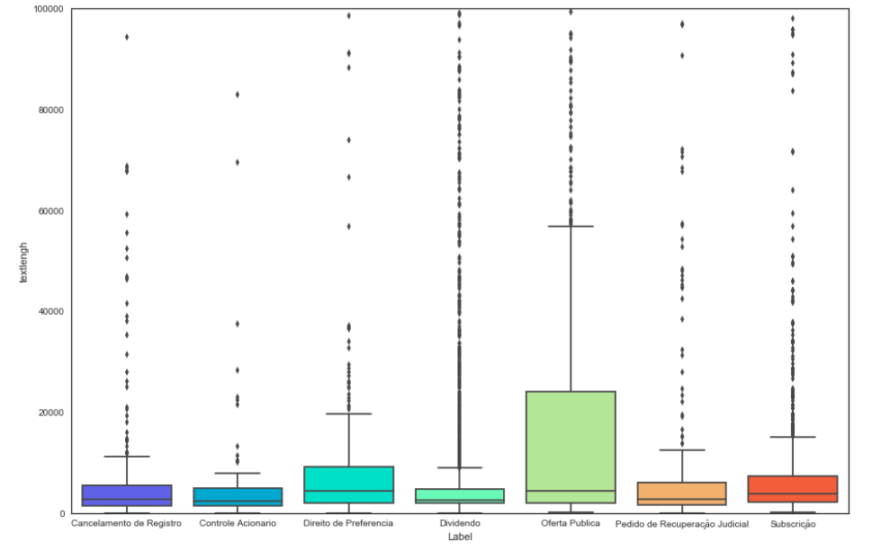

Slide 7
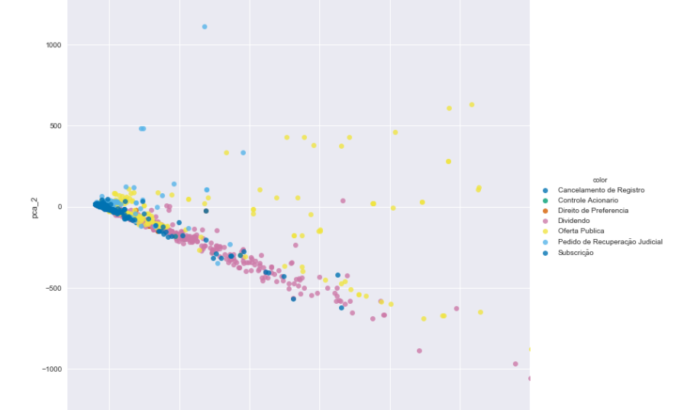
PCA Analysis

Slide 8
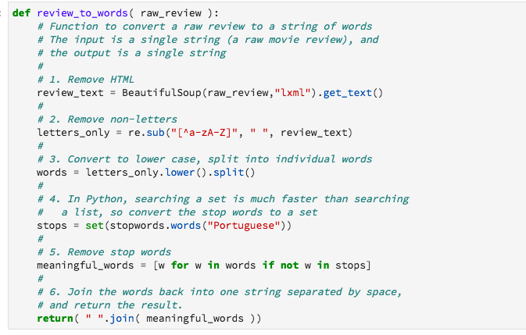
Cleaning Process

Slide 9
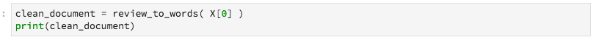
How to improve the pdfs text extraction?
tivit terceiriza processos servi tecnologia s cnpj mf nire edital segunda convoca assembleias gerais extraordin riasficam senhores acionistas tivit terceiriza processos servi ose tecnologia s convocados reunir assembleias geraisextraordin rias companhia ser realizadas segunda convoca julho sede social companhia localizada avenidaprefeito carlos ferreira lopes n cidade mogi cruzes estado s paulo s hs hs seguintes ordens dia assembleia geral extraordin ria ser realizada s hs aprova proposta plano op compra es emiss oda companhia termos minuta disponibilizada acionistas aconseq ente altera artigos item h estatuto social dacompanhia b aumento valor global remunera administradores assembleia geral extraordin ria ser realizada s hs aprova sa companhia novo mercado segmento especial denegocia bm fbovespa b sele acionistas n controladores companhia detentores dea es circula companhia conforme definido regulamento novomercado dentre seguintes institui es especializadas sercontratada elabora termos legisla regulamenta oaplic veis laudo avalia es companhia fins darealiza acionista dethalas empreendimentos participa es s oferta p blica sa novo mercado cancelamento

Slide 10
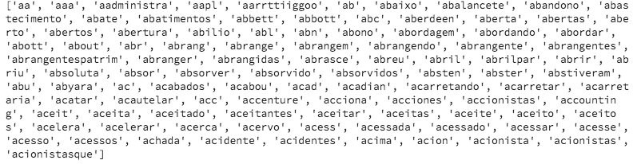
Dictionaries

Slide 11
Models
We tested four machine learning models
Naïve Bayes 84% accuracy
Randon Forest 88% accuracy
XGBBoost 91% accuracy
Deep Learning (DNN) 89% accuracy

Slide 12
XGBoost
 | precision | recall | f1-score | support
Cancelamento de Registro | 0.81 | 0.54 | 0.65 | 56
Stock Control | 0.87 | 0.74 | 0.80 | 27
Direito de Preferência / Right of first refusal | 0.84 | 0.42 | 0.56 | 65
Dividends | 0.96 | 1.00 | 0.98 | 783
Public Offering | 0.79 | 0.88 | 0.83 | 190
Request for Judicial Recovery / bankruptcy | 1.00 | 0.88 | 0.93 | 72
Share subscription | 0.81 | 0.87 | 0.84 | 175
avg / total | 0.91 | 0.91 | 0.90 | 1368

Slide 13
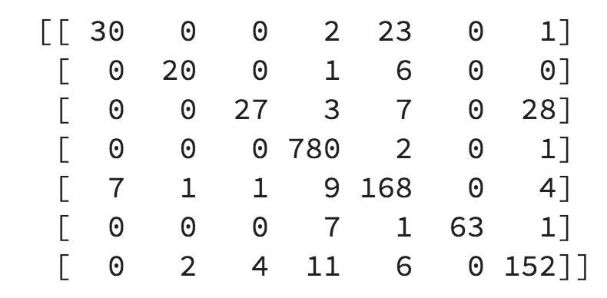

Slide 14
Next Steps
The results were obtained only with public data available at EmpresaNet
Metadata analysis
Financial Data indexes
Knowledge Engineering
Topic Modeling – LDA
Word Embeddings
Readability Score – FOG
Sentimental Analysis
Passive Voice for formal documents.

Slide 15
Thank you!

